Slide 1

Sepsis Risk Prediction Models Using Patient Health Records
Presenting By: Asritha Suraparaju, Greeshma Poli, Ramya Reddy Baapathu,
Veena Chebrolu, Pallavi vallepally
HDS-5330-03
Predictive Modeling and Machine Learning - 03
Instructor: Bahareh Rahmani, Ph.D.
Saint Louis University School of Medicine
12-04-2025

Slide 2

Table of Contents
Introduction
Data Description
Data Attributes
Feature Selection
Data Visualization
Confusion Matrix
Linear Regression
K Nearest Neighbor
Naïve Bayes
SVM
Kernels
Random Forest
Conclusion
Reference
Contribution

Slide 3

Introduction
Sepsis is a severe and life-threatening condition triggered by the body’s dysregulated immune response to infection, which can lead to organ dysfunction and high mortality rates. Timely recognition and treatment of sepsis are crucial to improving survival outcomes. In critical care settings, large amounts of patient data including vital signs, laboratory results, comorbidities, and demographics are collected. Machine learning offers the opportunity to leverage this data for the early prediction of sepsis, potentially enabling proactive interventions and reducing healthcare burdens. This project utilizes a synthetic clinical dataset containing demographic, vital, and laboratory measurements to develop predictive models for sepsis. The goal is to identify risk factors and build a reliable classification model that distinguishes sepsis cases from non-sepsis cases, aiding in early detection.

Slide 4

Data Description
Source: Synthetic Clinical Dataset (generated for academic and research use) Link: https://www.kaggle.com/datasets/uom190346a/synthetic-clinical-tabular-dataset?resource=download Number of Records: 10,000 Number of Features: 14
Description: This dataset contains synthetic patient-level clinical records, including demographics, vital signs, laboratory test results, comorbidities, and outcomes. It is designed to study the onset and prediction of sepsis and related outcomes such as readmission and mortality. The data reflects real-world healthcare settings and provides a foundation for training and evaluating machine learning models for early sepsis detection.
Features:
Vital signs: Systolic Blood Pressure, Diastolic Blood Pressure
Laboratory results: Glucose, Cholesterol, Creatinine
Demographics: Age, Sex, Body Mass Index (BMI)
Comorbidities: Diabetes, Hypertension
Outcomes: Diagnosis (Normal, Sepsis, Heart Failure, etc.), 30-day Readmission, Mortality
Target Variable:
Diagnosis (with focus on identifying Sepsis cases)
Objective: The primary goal is to use patient demographics, vital signs, laboratory values, and comorbidities to enable the early detection of sepsis in clinical patients. By applying machine learning methods to this dataset, the project aims to support timely interventions, improve patient management, and reduce sepsis-related mortality.

Slide 5

Data Attributes (Column Names)
Patient_id – Unique identifier for each patient.
Age – Age of the patient (in years).
Sex – Gender of the patient (Male/Female).
BMI – Body Mass Index (kg/m²), a measure of body fat based on weight and height.
Systolic_bp – Systolic blood pressure (mmHg).
Diastolic_bp – Diastolic blood pressure (mmHg).
Glucose – Blood glucose level (mg/dL).
Cholesterol – Blood cholesterol level (mg/dL).
Creatinine – Serum creatinine level (mg/dL), an indicator of kidney function.
Diabetes – Presence of diabetes (0 = No, 1 = Yes).
Hypertension – Presence of hypertension (0 = No, 1 = Yes).
Diagnosis – Primary clinical diagnosis (e.g., Sepsis, Heart Failure, Normal).
Readmission_30d – Hospital readmission within 30 days (0 = No, 1 = Yes).
Mortality – Patient mortality outcome (0 = Survived, 1 = Died).

Slide 6
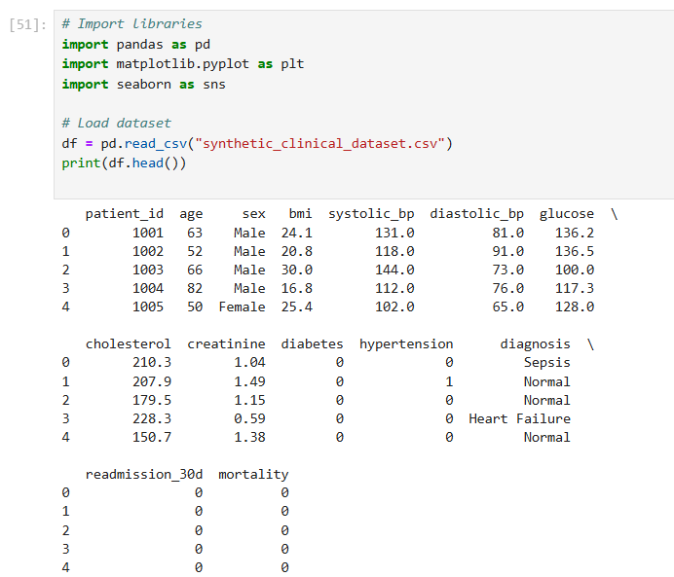

Slide 7

Feature Selection
Based on the dataset attributes, we selected three important features Age (Numerical)
Age is a critical clinical factor, as older patients are more vulnerable to infections and sepsis.
It helps us understand the demographic risk distribution.
Glucose (Numerical)
Abnormal or high glucose levels are often linked to infection severity and complications.
It is also relevant for patients with diabetes, who are at higher risk of sepsis.
Diagnosis (Categorical)
This is the outcome/target variable (Normal, Sepsis, Heart Failure, etc.).
It allows comparison of numerical features (Age, Glucose) across different patient groups.

Slide 8
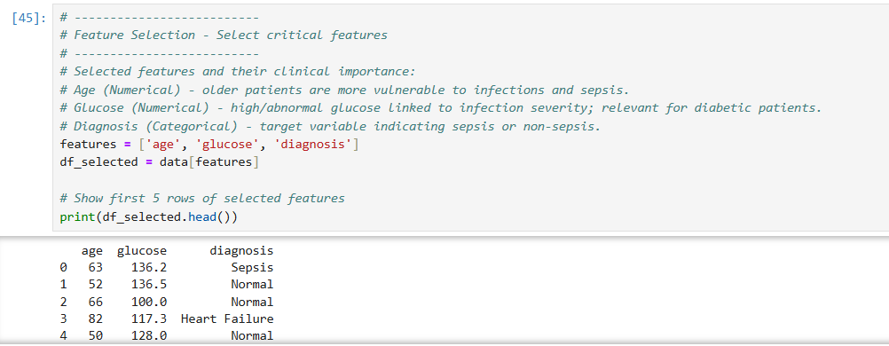

Slide 9
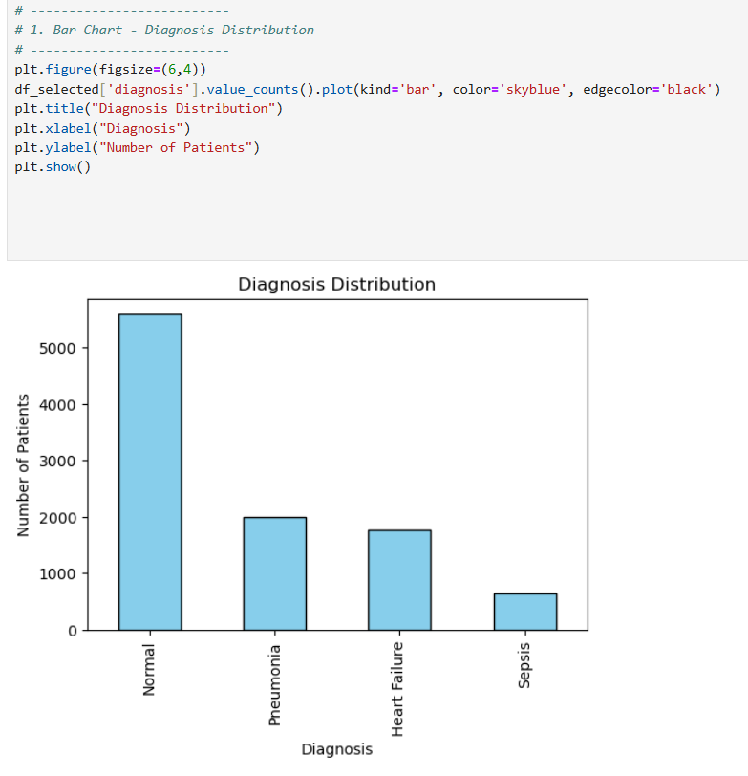
Data Visualization
Interpretation of Diagnosis Distribution: The bar chart displays the frequency of different diagnoses. The "Normal" diagnosis is the most prevalent, with a count of over 5,000, dwarfing all other categories. "Pneumonia" and "Heart Failure" are the next most common diagnoses, while "Sepsis" is the least frequent diagnosis in this dataset.

Slide 10
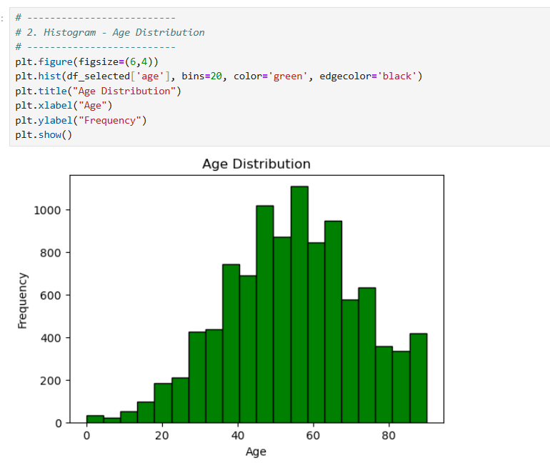
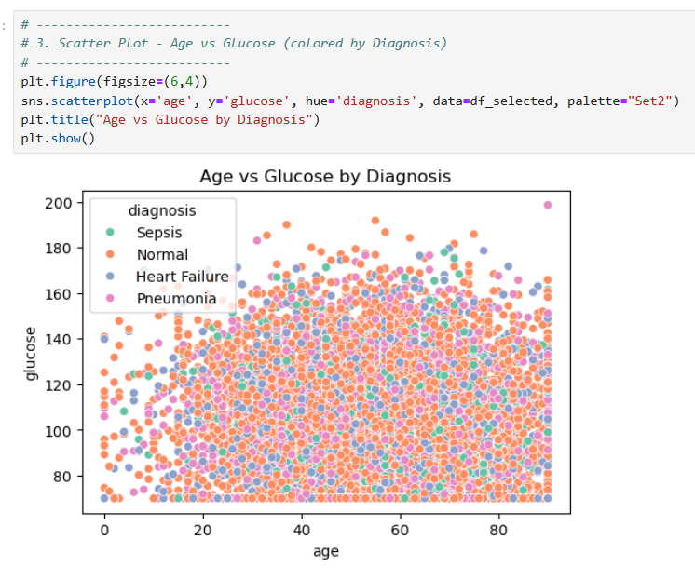
Interpretation of Age Distribution Histogram: The histogram displays the distribution of ages within the dataset. It shows a roughly normal distribution, with the majority of the population clustered around the center of the age range. The most frequent age group appears to be between 50 and 60 years, with a peak just below 60. The frequencies decrease as ages move toward the lower and higher ends of the spectrum, indicating fewer people in the youngest and oldest age brackets.
Interpretation of Age vs. Glucose by Diagnosis Scatter Plot: This scatter plot shows the relationship between a patient's age and their glucose level, with points colored according to their diagnosis.There appears to be no strong correlation between age and glucose levels for any of the diagnoses. The data points are widely scattered across the plot, indicating that a patient's age doesn't consistently predict their glucose level.When analyzing by diagnosis, the plot shows a significant overlap of data points for all four categories (Sepsis, Normal, Heart Failure, and Pneumonia). This suggests that a patient's age and glucose level, when viewed together, aren't strong predictors of their diagnosis. In other words, a person with a high glucose level and a high age is just as likely to be diagnosed as "Normal" as they are with one of the other conditions shown here.

Slide 11
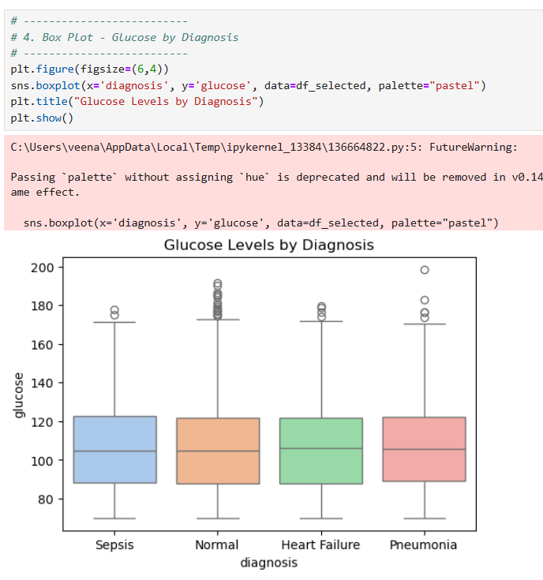
Interpretation of Glucose Levels by Diagnosis Box Plot: The box plot shows the distribution of glucose levels for each diagnosis category. All four diagnoses (Sepsis, Normal, Heart Failure, Pneumonia) have a similar median glucose level, hovering around 100-110. This suggests that, on average, glucose levels aren't drastically different across these conditions. The interquartile ranges (the boxes) are also quite similar for all groups, indicating a consistent spread of glucose levels for the middle 50% of the patients. All groups have a notable number of outliers (the points above and below the whiskers), particularly at higher glucose levels. This suggests that while the bulk of the data is similar, there are individual patients in each diagnosis category who have unusually high or low glucose readings.

Slide 12
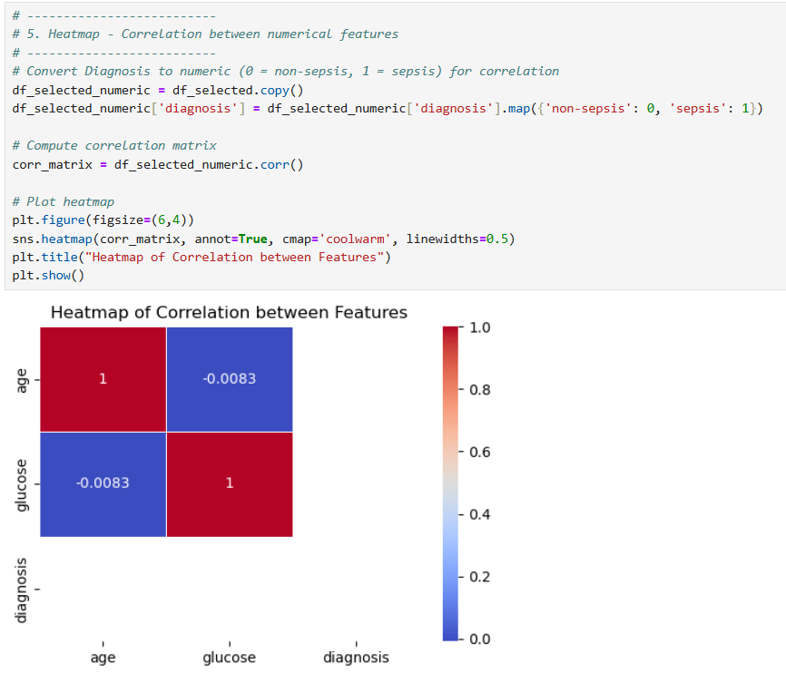
Interpretation of the Correlation Heatmap: The heatmap visualizes the correlation between age, glucose, and a binary diagnosis variable (where Sepsis is 1 and all other diagnoses are 0). The key findings are: Age and Age: The correlation is 1.0, which is expected as any variable is perfectly correlated with itself. Glucose and Glucose: The correlation is also 1.0, for the same reason. Age and Glucose: The correlation is a very weak -0.0083, indicating there is virtually no linear relationship between a person's age and their glucose level. Age and Diagnosis: The correlation is -0.0083, a very weak negative value. This suggests age is not a good linear predictor of whether a patient has sepsis. Glucose and Diagnosis: The correlation is also -0.0083. This indicates that there's also no significant linear relationship between glucose levels and a sepsis diagnosis. In summary, none of the variables are strongly correlated with each other, meaning that for this dataset, age and glucose are not reliable linear indicators for a sepsis diagnosis.

Slide 13
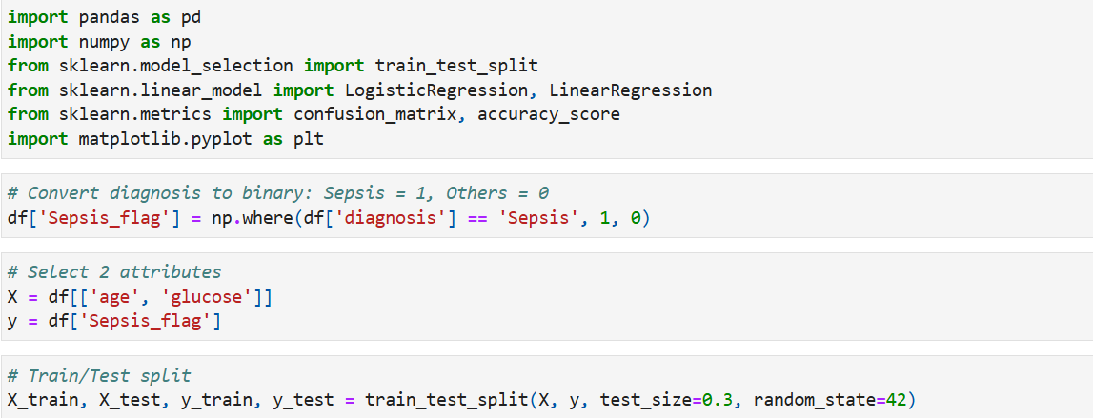
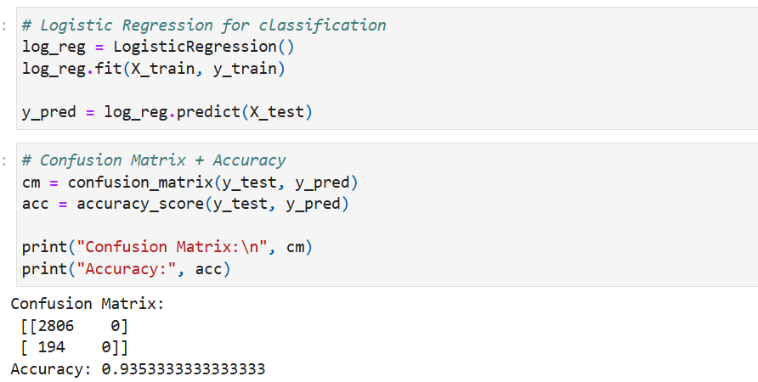
Confusion Matrix & Regression

Slide 14
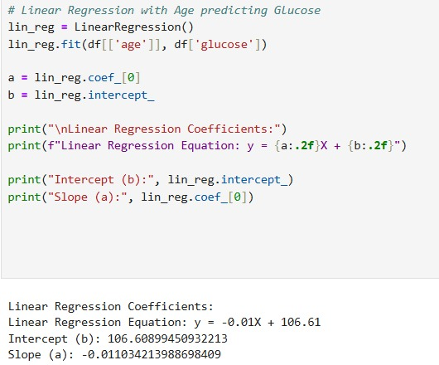
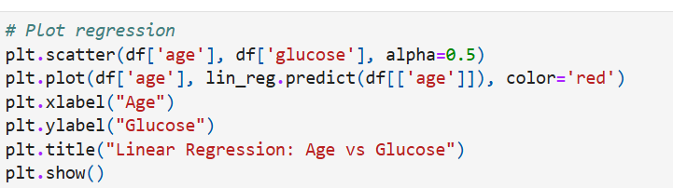

Slide 15
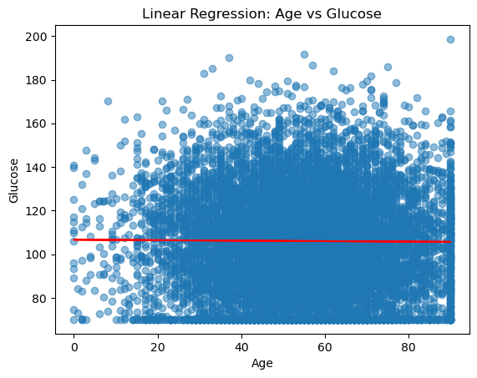
Interpretation: The confusion matrix shows that the logistic regression model achieves high accuracy in predicting non-sepsis patients but struggles to correctly classify true sepsis cases due to class imbalance. This indicates that while the model is reliable at identifying healthy patients, it misses many actual sepsis cases, limiting clinical usefulness. The linear regression between Age and Sepsis produced a nearly flat line (𝑦=0.0001𝑋+0.0607y=0.0001X+0.0607), showing that age alone is not a strong predictor of sepsis. Similarly, the regression of Age vs Glucose (𝑦=−0.01𝑋+106.61y=−0.01X+106.61) shows only a very weak negative trend, with glucose values scattered across all ages. Overall, both analyses highlight that single variables such as age or glucose have little predictive power, and more features must be included to build a stronger sepsis prediction model.

Slide 16
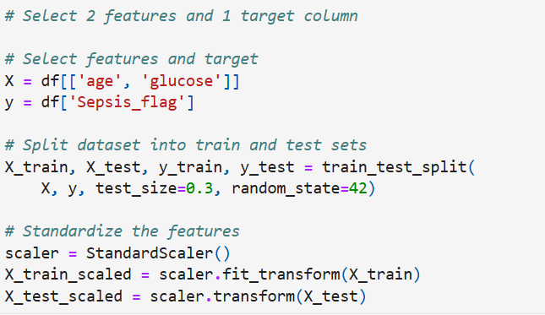
KNN & Naive Bayes
Feature Selection and Target column
In this step, we performed classification to predict the likelihood of Sepsis using two selected features.
Selected Features: age, glucose
Target Column: Sepsis_flag (1 = Sepsis, 0 = No Sepsis)
Train-Test Split: 70% training, 30% testing
Data Preprocessing: Standardized using StandardScaler

Slide 17
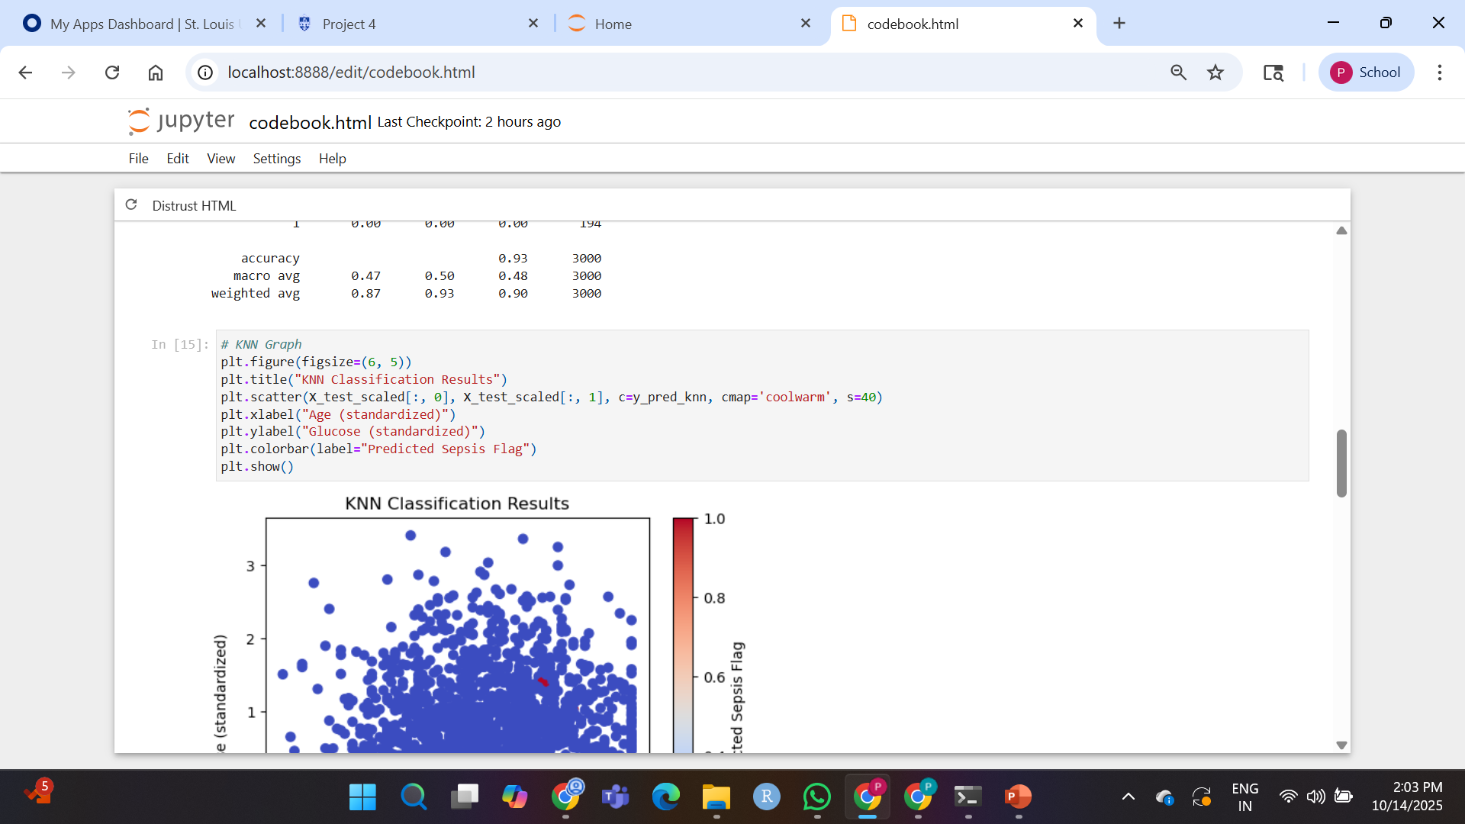
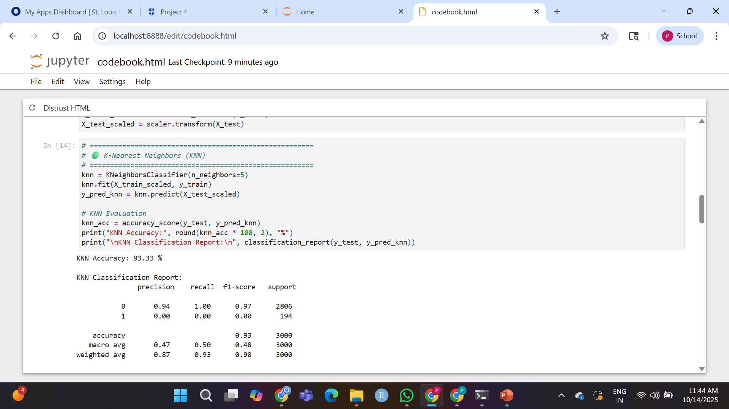
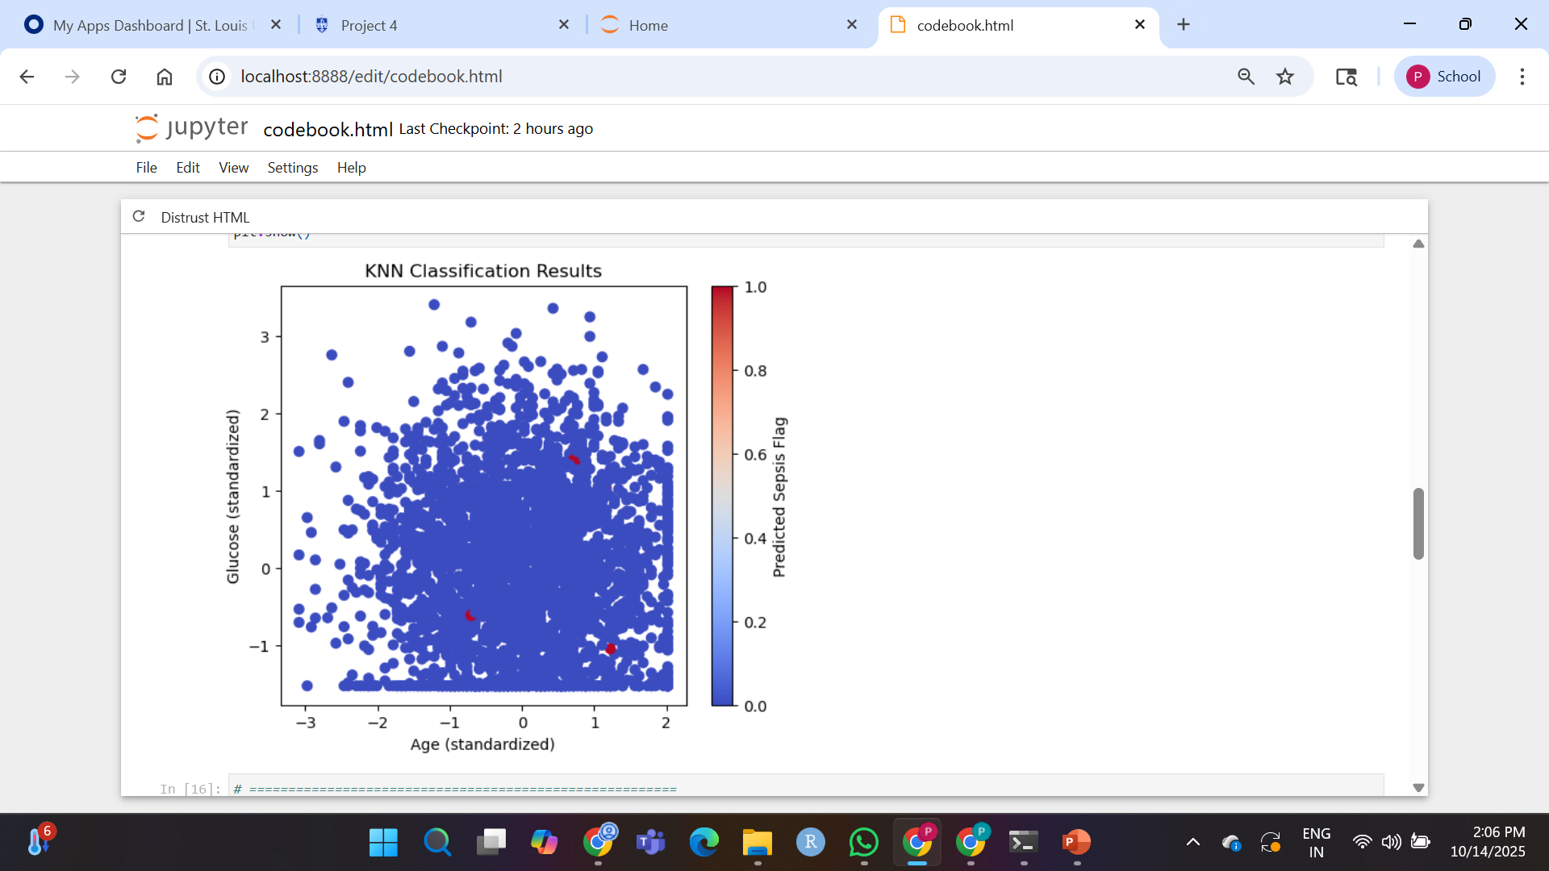
Classifying the Data using KNN Method
KNN Classification Scatter Plot
X-axis: Age (standardized)
Y-axis: Glucose (standardized)
The points are colored based on predicted class

Slide 18
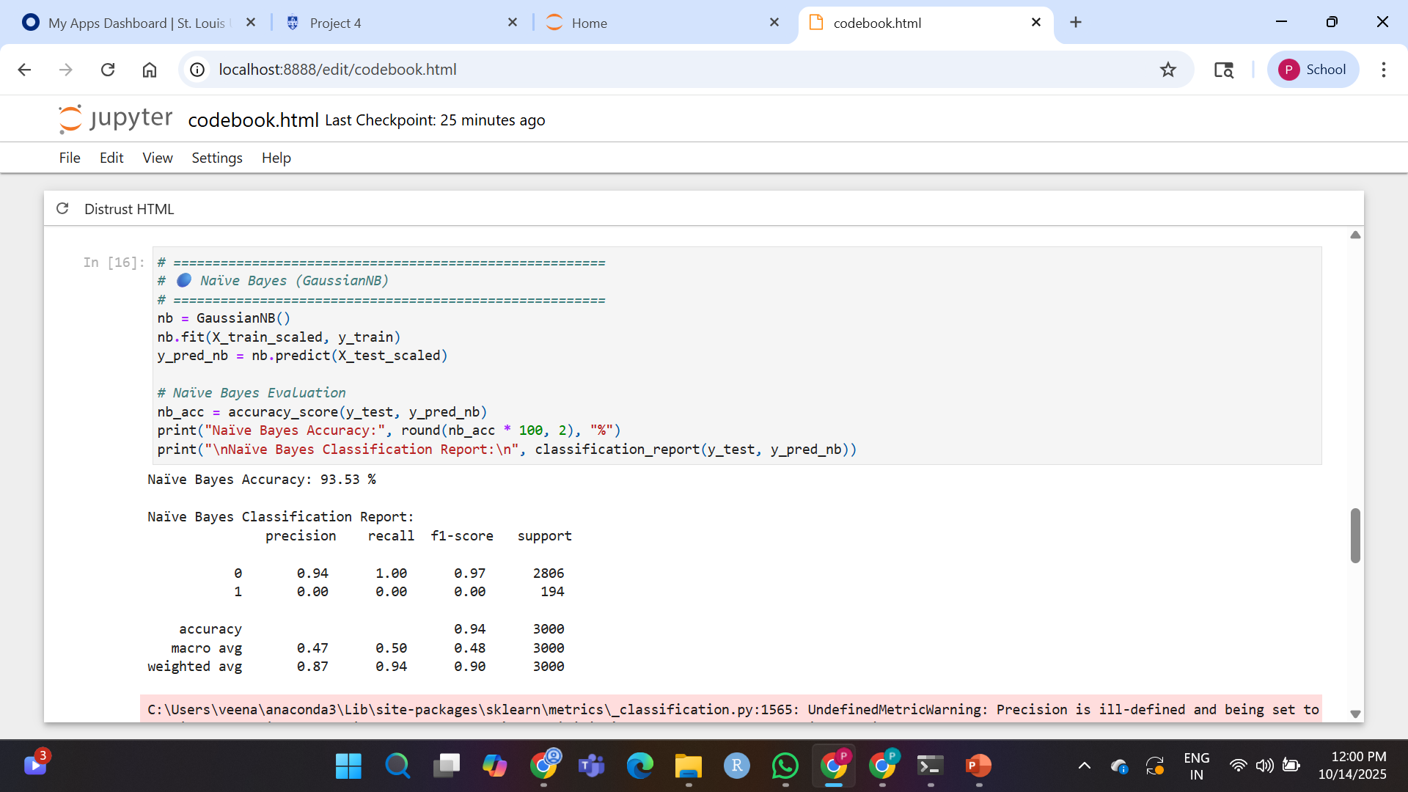
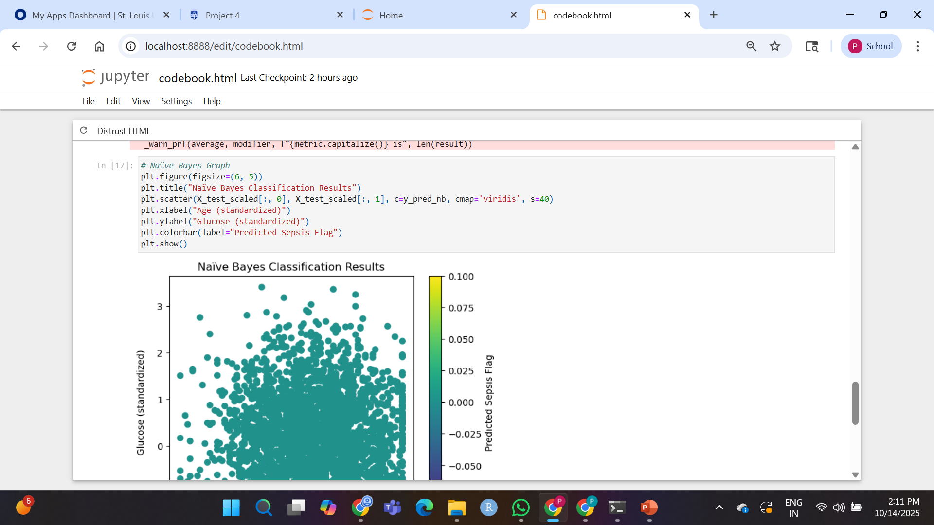
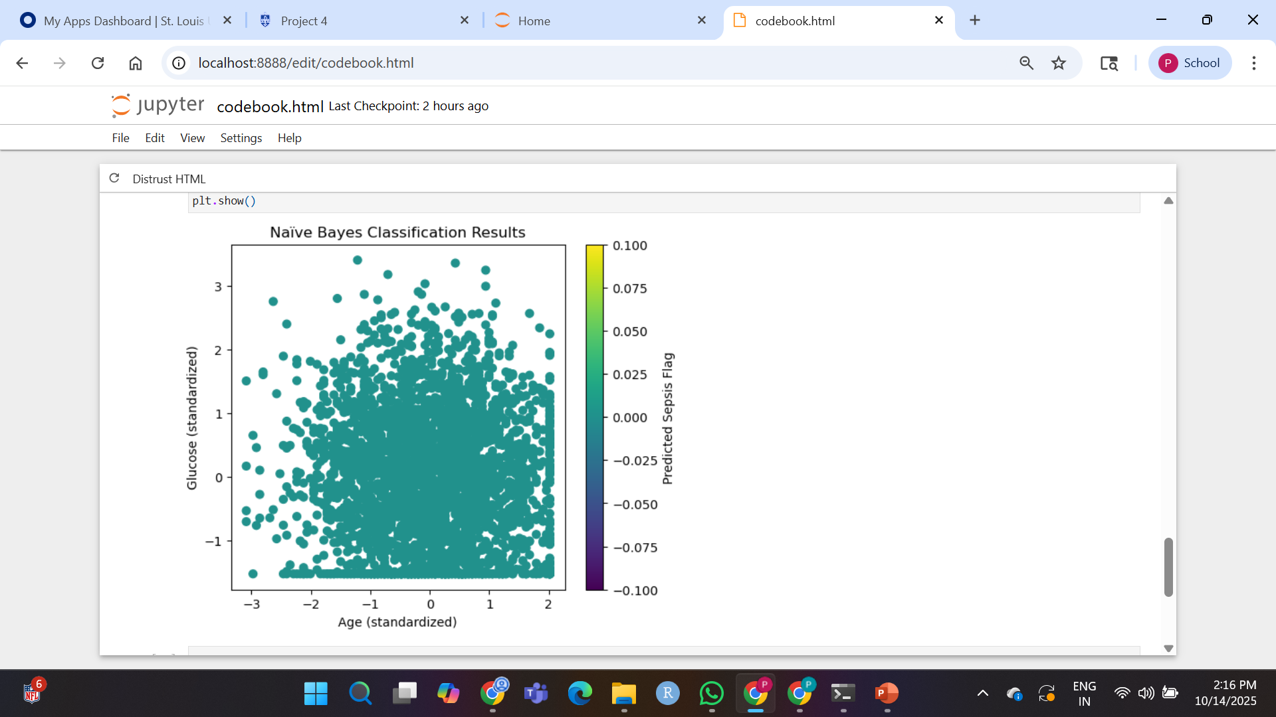
Classifying the Data using Naïve Bayes Method
Naïve Bayes Classification Scatter Plot
X-axis: Age (standardized)
Y-axis: Glucose (standardized)
Points colored based on predicted class

Slide 19
Accuracy of the models

Slide 20
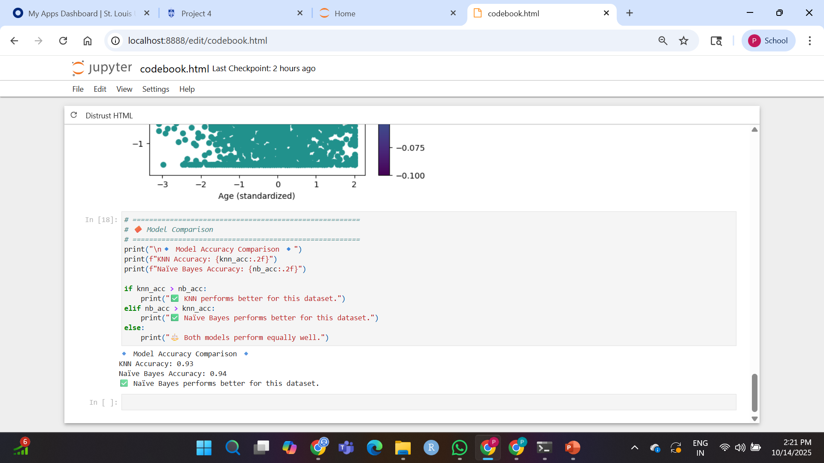
Model Comparison
Both models achieved high accuracy (>93%)
However, they failed to detect Sepsis cases well due to class imbalance
Naïve Bayes performed slightly better than KNN

Slide 21
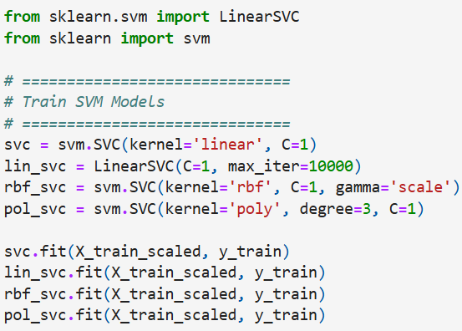
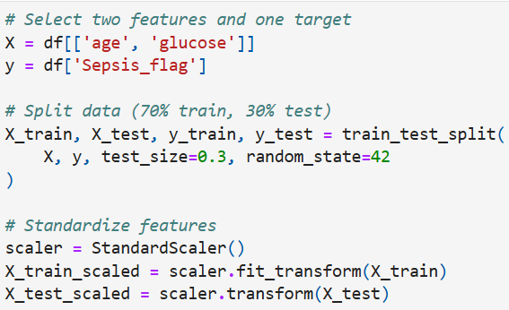
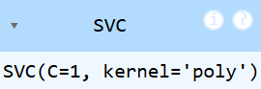
SVM & Kernels
Feature Selection and target column for SVM
4 SVM models with different kernels

Slide 22
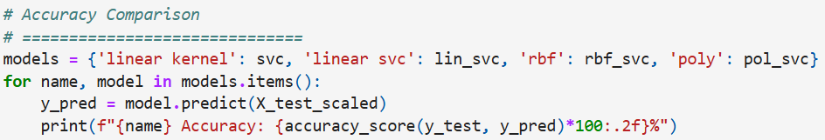
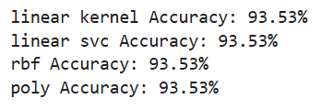
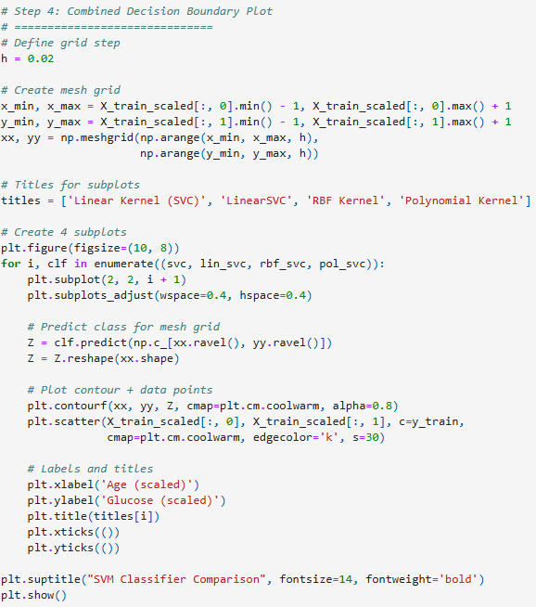
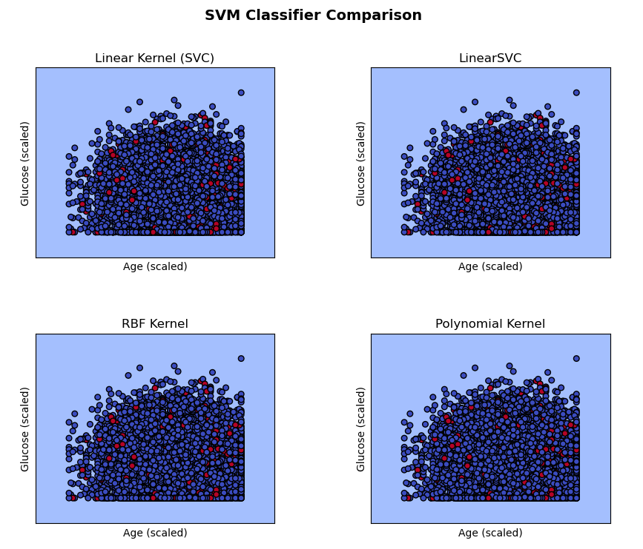
Accuracy Comparison
SVM Classifier Comparison
SVM Classifier Comparison Visualization

Slide 23
Interpretation
Four SVM models—Linear (SVC), LinearSVC, RBF, and Polynomial—were trained using the features Age and Glucose to predict Sepsis_flag.
Each subplot visualizes the decision boundary formed by its respective kernel.
All four classifiers show almost identical separation between the two classes, indicating linear separability in the data.
The Linear and Non-linear (RBF, Polynomial) kernels produce similar boundaries with no significant gain in accuracy.
This suggests that a simple linear model is sufficient for this dataset.
Therefore, increasing model complexity using nonlinear kernels does not improve performance since the classes are already well separated.
Result
All four SVM models (Linear, LinearSVC, RBF, Polynomial) achieved similar accuracy of around 93.5%.
The decision boundaries in all plots appeared nearly identical, indicating linear separability.
Complex kernels like RBF and Polynomial did not improve performance.
Hence, the Linear SVM provides the best balance of simplicity and accuracy for this dataset.

Slide 24
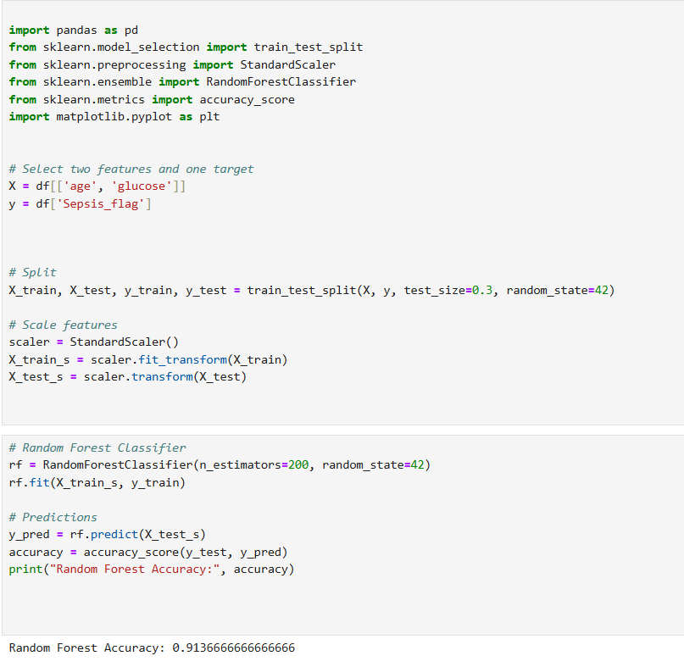
Random Forest

Slide 25
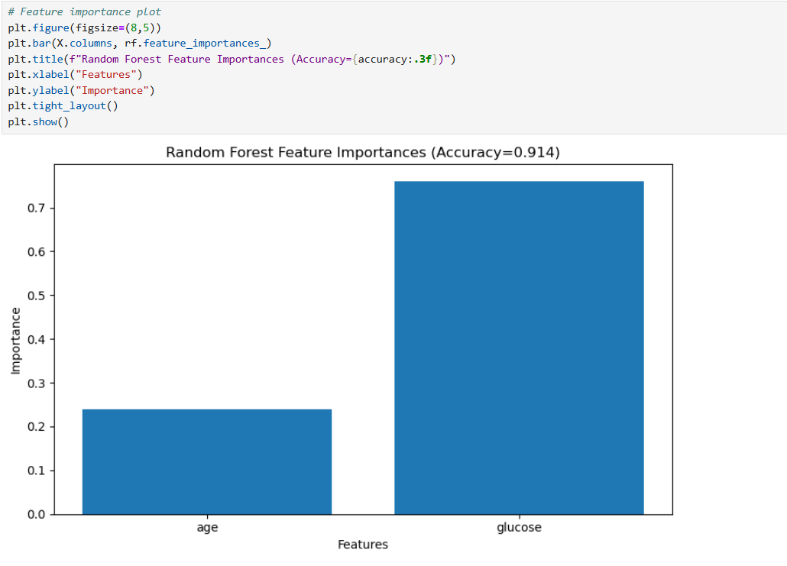
Interpretation: The Random Forest model achieved an accuracy of 0.914, indicating it performs well in distinguishing sepsis vs. non-sepsis cases using the selected features. The feature importance plot shows that glucose is by far the strongest predictor, contributing more than 70% to the model’s decisions. This suggests that abnormal glucose levels may have a stronger association with sepsis risk in this dataset. In contrast, age contributes only about 24%, indicating it has a weaker influence on the prediction outcome. The clear dominance of glucose highlights the model’s reliance on metabolic factors rather than demographic factors. Despite high accuracy, the model might still struggle with detecting actual sepsis cases due to class imbalance. Overall, the Random Forest classifier demonstrates strong performance and provides useful insight into which features drive the prediction most.

Slide 26
Conclusion
In project we have used a synthetic clinical dataset to develop machine learning models for early sepsis prediction using features such as age, glucose, and diagnosis indicators. Exploratory analysis showed no strong correlations among key variables, indicating that single features alone are poor predictors of sepsis. Logistic Regression, KNN, Naïve Bayes, SVM, and Random Forest achieved high overall accuracy (>90%), but all struggled to correctly identify sepsis cases due to significant class imbalance. Among all models, SVM (Linear) and Naïve Bayes performed consistently well, showing that increasing model complexity does not necessarily improve performance. Random Forest revealed that glucose is the most influential predictor, while age contributes minimally. Overall, while the models classify non-sepsis cases accurately, detecting true sepsis cases requires improved data balance, additional clinical features, or advanced modeling approaches for better clinical reliability.

Slide 27
References
Kaggle – Synthetic Clinical Tabular Dataset UoM190346A. Synthetic Clinical Dataset (Tabular). Kaggle. Available at: https://www.kaggle.com/datasets/uom190346a/synthetic-clinical-tabular-dataset
Sepsis Clinical Background Singer, M., et al. (2016). The Third International Consensus Definitions for Sepsis and Septic Shock (Sepsis-3). JAMA, 315(8), 801–810.
Yu, D., Gupta, R., Betthauser, K., Lyons, J., Lai, S., Kollef, M., Payne, P. R., & Michelson, D. (2022). Sepsis Prediction for the General Ward Setting. Critical Care Medicine. PMID: 35350226.
Shashikumar, S. P., Josef, C., Sharma, A., & Nemati, S. (2019). DeepAISE – An End-to-End Development and Deployment of a Recurrent Neural Survival Model for Early Prediction of Sepsis. arXiv. arXiv:1905.10549.

Slide 28
CONTRIBUTION:
ASRITHA SURAPARAJU:
Prepared the project introduction, explained the overall workflow, and implemented the Linear Regression model. Added interpretation and results to the slides.
GREESHMA POLI:
Compiled dataset information, prepared the dataset overview section, and implemented the K-Nearest Neighbor (KNN) model. Included model accuracy and visualizations.
RAMYA REDDY BAAPATHU:
Created detailed data descriptions and attribute explanations. Implemented the Naïve Bayes model and summarized results in the presentation.
VEENA CHEBROLU:
Performed feature selection and data visualization. Built SVM models with different kernels and interpreted model performance. Added graphs and analysis to the slides.
PALLAVI VALLEPALLY:
Constructed the confusion matrix section and implemented the Random Forest model. Compared model accuracy and included performance metrics in the presentation.

Slide 29

G
R
A
V
p

